Slide 1
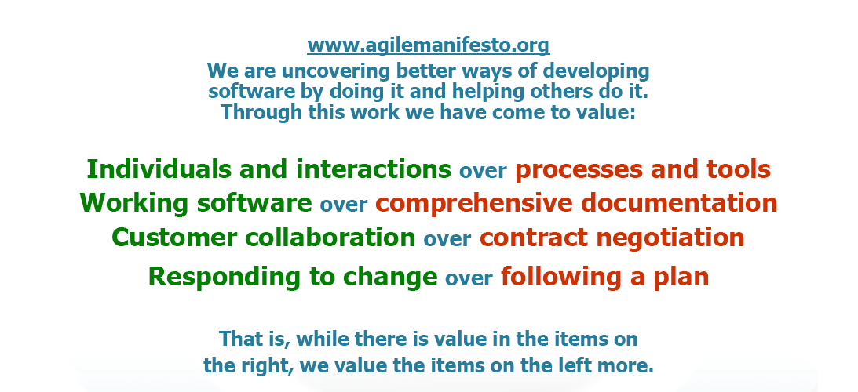
Agile Manifesto (2001)
http://agilemanifesto.org/
Notes:
2013-01-24
Speakers notes:
Background:
17 people met at the ”The Lodge” in Snowbird, a ski resort in the Wasatch mountains in, Utah, February 2001. Representatives for XP, (eXtremeProgramming) Scrum, Adaptive Software Development, Crystal, Feature-Driven Development (to mention some of the representatives). The group founded the Agile Manifesto and the Agile Principles at his occasion.
Something worth considering:
It is clear that no matter the well defined processes and advanced tools made available for a team; if the persons in the team can not cooperate the processes and tools doesn't make a difference. It is more important to secure that the Team can work together as persons to get efficiency, speed and quality.
A typical user of a system will approve better with a well functioning SW rather than a complex manual or specification. The main goal is to develop products, not necessarily develop documentation.
Reduce the risk for misunderstandings by communicate changes early rather than wait for the requirement specification.
Course Documentation Ericsson R&D Agile & Lean Basics

Slide 2
Principles behind the Agile Manifesto
Our highest priority is to satisfy the customer through early and continuous delivery of valuable software.
Welcome changing requirements, even late in development. Agile processes harness change for the customer's competitive advantage.
Deliver working software frequently, from a couple of weeks to a couple of months, with a preference to the shorter timescale.
Business people and developers must work together daily throughout the project.
Build projects around motivated individuals. Give them the environment and support they need, and trust them to get the job done.
The most efficient and effective method of conveying information to and within a development team is face-to-face conversation.
Notes:
2013-01-24
Speakers notes:
Background:
17 people met at the ”The Lodge” in Snowbird, a ski resort in the Wasatch mountains in, Utah, February 2001. Representatives for XP, (eXtremeProgramming) Scrum, Adaptive Software Development, Crystal, Feature-Driven Development (to mention some of the representatives). The group founded the Agile Manifesto and the Agile Principles at his occasion.
Course Documentation Ericsson R&D Agile & Lean Basics

Slide 3
Principles behind the Agile Manifesto
Working software is the primary measure of progress.
Agile processes promote sustainable development. The sponsors, developers, and users should be able to maintain a constant pace indefinitely.
Continuous attention to technical excellence and good design enhances agility.
Simplicity--the art of maximizing the amount of work not done--is essential.
The best architectures, requirements, and designs emerge from self-organizing teams.
At regular intervals, the team reflects on how to become more effective, then tunes and adjusts its behavior accordingly.
Notes:
2013-01-24
Speakers notes:
Something worth considering:
It is clear that no matter the well defined processes and advanced tools made available for a team; if the persons in the team can not cooperate the processes and tools doesn't make a difference. It is more important to secure that the Team can work together as persons to get efficiency, speed and quality.
A typical user of a system will approve better with a well functioning SW rather than a complex manual or specification. The main goal is to develop products, not necessarily develop documentation.
Reduce the risk for misunderstandings by communicate changes early rather than wait for the requirement specification.
Course Documentation Ericsson R&D Agile & Lean Basics

Slide 4
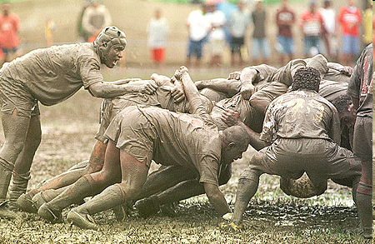
SCRUM
Notes:
2013-01-24

Slide 5
Scrum Overview
Scrum is an Agile process;
Used to manage complex projects since 1990;
Delivers business functionality in 30 days;
Business sets the priorities;
Teams self-organize to determine the best way to deliver the highest priority features.
Scalable to distributed, large, and long projects;
Extremely simple but very hard!
Notes:
2013-01-24

Slide 6
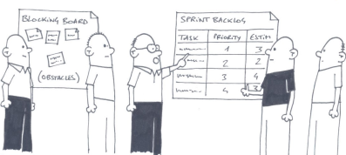
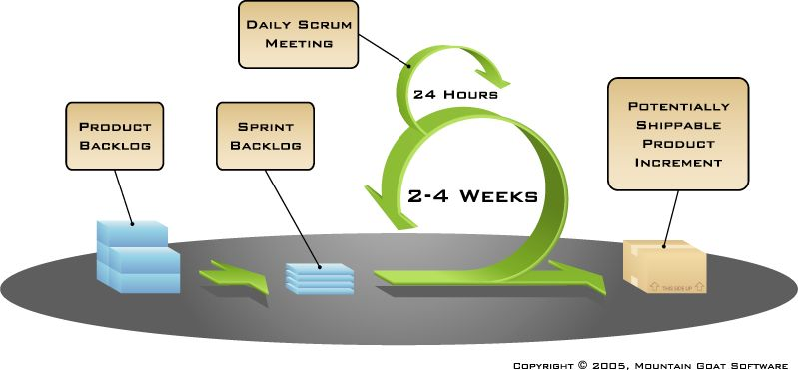

Scrum - framework
Timeboxing!
Sprint planning – “definition of Done”
Sprint review – “the demo”
Sprint retrospective
Daily scrum meeting
Scrum master
team
Product owner
Notes:
2013-01-24

Slide 7

Cross functional team
Doesn’t mean everyone has to know everything
I can test, but I’m not so good at it.
Skills Needed to implement Top X backlog items
Product
Backlog
I don’t know CM at all. But I’m willing to learn!
Test
DB
Web
Java
Domain
CM
I’m good at Java!
Lisa
Joe
Fred
Jenny
David
Erik
I won’t even go near a database!
Notes:
2013-01-24

Slide 8
Team
Seven (plus/minus two) members
Is cross-functional (Skills in testing, coding, architecture etc.)
Selects the Sprint goal and specifies work results
Has the right to do everything within the boundaries of the project guidelines to reach the Sprint goal
Organizes itself and its work
Demos work results to the Product Owner.
Notes:
2013-01-24

Slide 9
Scrum Master
Ensure that the team is fully functional and productive
Enable close cooperation across all roles and functions
Remove barriers
Shield the team from external interferences during the Sprint
Ensure that the process is followed, including issuing invitations to Daily Scrum, Sprint Review and Sprint Planning meetings.
Notes:
2013-01-24

Slide 10
Product Owner
Define the features of the product.
Decide on release date and content.
Be responsible for the profitability of the product (ROI).
Prioritize features according to market value.
Adjust features and priority every iteration, as needed
Accept or reject work results.
Notes:
2013-01-24

Slide 11
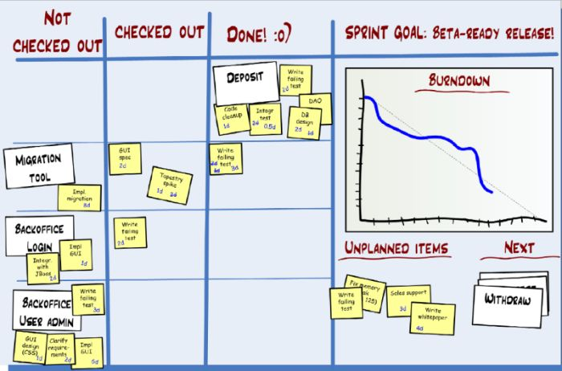
Burndown Chart
Notes:
The Burndown Chart tracks your progress in the sprint. It measures the amount of work remaining in the sprint, or the estimated amount of work remaining in the sprint. It lets the team see at a glance if they are on track to deliver the sprint backlog.
2013-01-24

Slide 12
KANBAN
Notes:
2013-01-24

Slide 13

看板 – Kanban cards limit excess work in progress
看板 – kanban literally means “visual card,” “signboard,” or “billboard.”
Toyota originally used Kanban cards to limit the amount of inventory tied up in “work in progress” on a manufacturing floor
kanban cards act as a form of “currency” representing how WIP is allowed in a system.
Kanban is an emerging process framework that is growing in popularity since it was first discussed at Agile 2007 in Washington D.C.
Notes:
kanban_eth
2010-06-16
Kanban

Slide 14


Kanban basic rules
Visualize the workflow
Limit Work In Progress (WIP)
Measure and manage flow
Make process policies explicit
Improve Collaboratively (using models/scientific method)
backlog
study
implement
integrate
test
done
2
4
1
3
Lead time until done
Cycle time of impl.
Notes:
2013-01-24

Slide 15
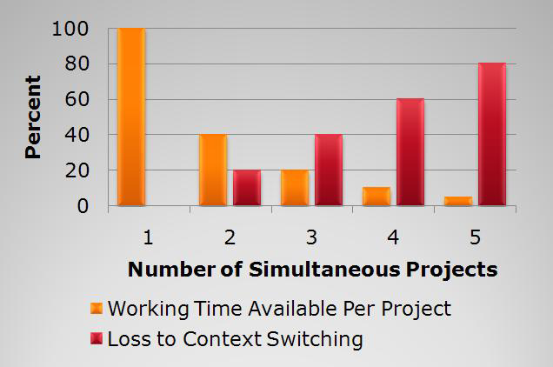
Limiting Work In Progress
20% time is lost to context switching per task, so fewer tasks means less time lost (from Gerald Weinberg, Quality Software Management: Systems Thinking)
Notes:
2013-01-24

Slide 16
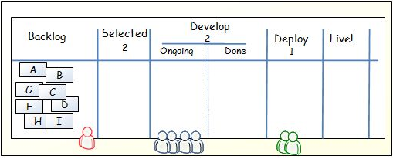
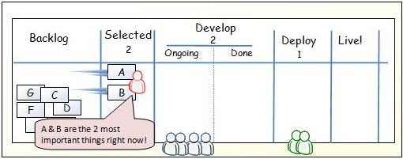
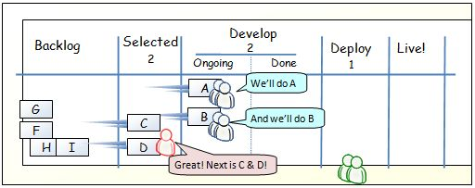
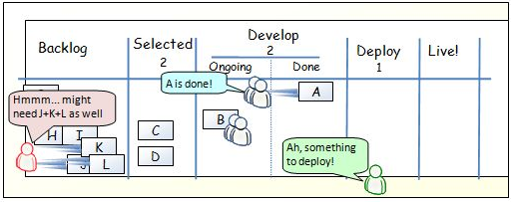
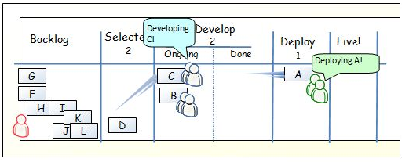
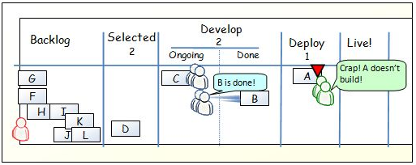
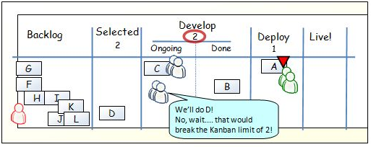
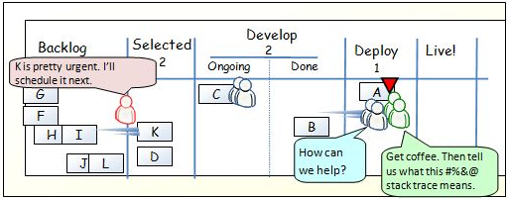
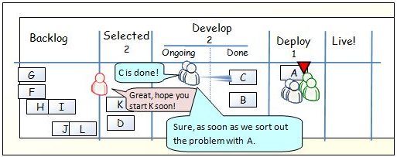
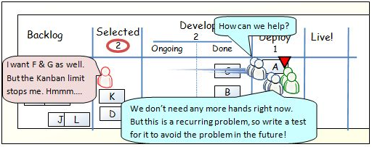
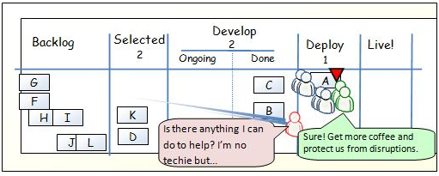
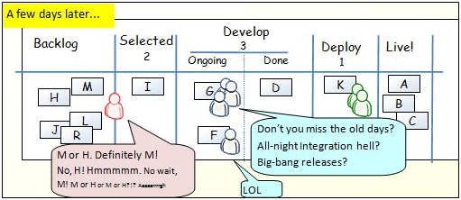
One day in kanban land
Notes:
2013-01-24

Slide 17
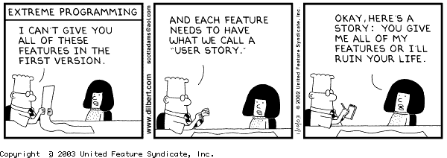
eXtreme Programming
Notes:
2013-01-24

Slide 18
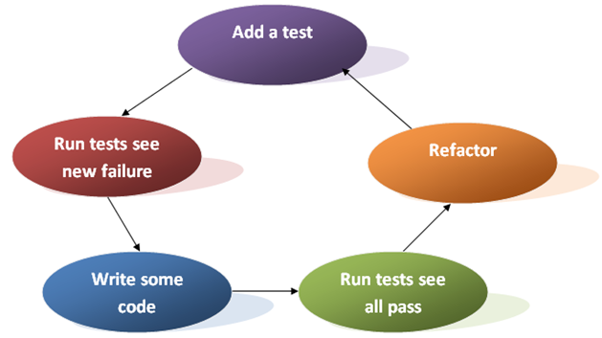
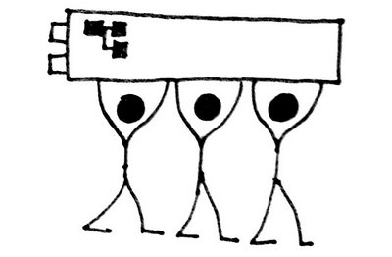
EXTREME PROGRAMMING (XP)
EXAMPLE OF PRINCIPLES
Test Driven Development
Test Automation
Continuous Integration
Collective Code Ownership
Pair Programming
Notes:
Course Documentation Ericsson R&D Agile & Lean Basics

Slide 19
eXtreme Programming practices
Fine scale feedback
  Pair programming
  Planning game
  Test-driven development
  Whole team
Continuous process
  Continuous integration
  Refactoring or design improvement
  Small releases
Shared understanding
  Coding standards
  Collective code ownership
  Simple design
  System metaphor
Programmer welfare
  Sustainable pace
Coding
  The customer is always available
  Code the Unit test first
  Only one pair integrates code at a time
  Leave Optimization until last
  No Overtime
Testing
  All code must have Unit tests
  All code must pass all Unit tests before it can be released.
  When a Bug is found tests are created before the bug is addressed (a bug is not an error in logic, it is a test you forgot to write)
  Acceptance tests are run often and the results are published
Notes:
2013-01-24

